Slide 1

Pestora
A Confidence-Aware AI Pest Monitoring System
By Kapakayala Siva Sai Pavan & Alaghari Sai Preetam
Department of Mathematics & Computer Science
Sri Sathya Sai Institute of Higher Learning, Nandigiri Campus

Slide 2

The Problem: Silent Threats to Indian Agriculture
Crop Loss Crisis
Pest infestation is a major cause of crop loss in Indian agriculture, leading to significant economic setbacks for farmers.
Manual Detection Flaws
Current manual pest detection methods rely heavily on experience and guesswork, often resulting in late identification.
Chemical Overuse
Late detection drives the preventive overuse of chemicals, harming soil health, food safety, and the environment.
Generic AI Limitations
Existing AI solutions are often generic, not crop-specific, and lack crucial prediction confidence for effective decision-making.

Slide 3

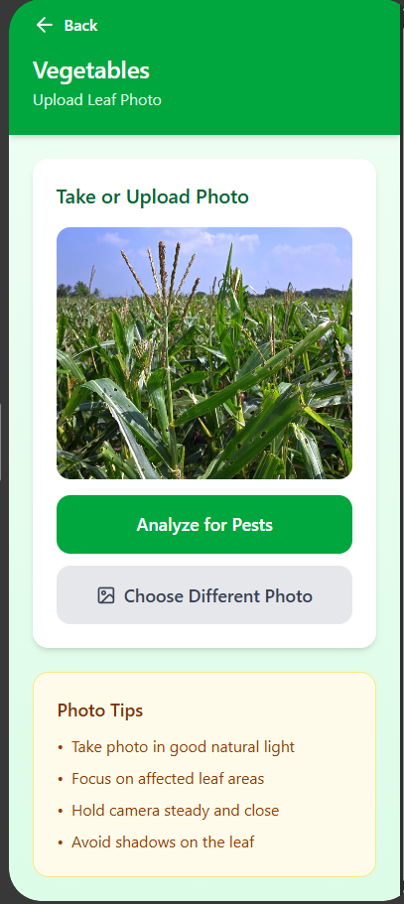
Our Solution – Pestora: Empowering Farmers with Precision AI
Pestora is an innovative, AI-based crop-specific pest monitoring system designed to revolutionize pest management in Indian agriculture.
Crop-Specific Models
1
Utilizes separate, highly specialized ML models for key crops like vegetables, rice, and maize for accurate detection.
Leaf Image Detection
2
Identifies pest damage through detailed analysis of leaf images, making it accessible and practical for farmers.
Confidence Scores
3
Every prediction includes a clear confidence score, allowing farmers to make informed and precise decisions.
Informed Action
4
Empowers farmers to take timely and appropriate action, reducing uncertainty and minimizing crop loss.

Slide 4
The Pestora Journey: From Image to Informed Action
Our system streamlines the pest detection process, guiding farmers through easy steps to effective pest management.
01
02
03
Data Collection
Model Training
Image Upload & Crop Selection
Crop-specific image data is meticulously collected to build robust AI models.
Data is cleaned and utilized to train sophisticated machine learning models tailored for each crop.
Farmers easily upload leaf images and select the corresponding crop type.
04
05
AI Prediction
Tailored Advisory
Pestora's AI instantly predicts pest type, severity, and crucial confidence score.
An advisory is provided, prioritizing organic solutions and recommending approved chemicals only when necessary.

Slide 5
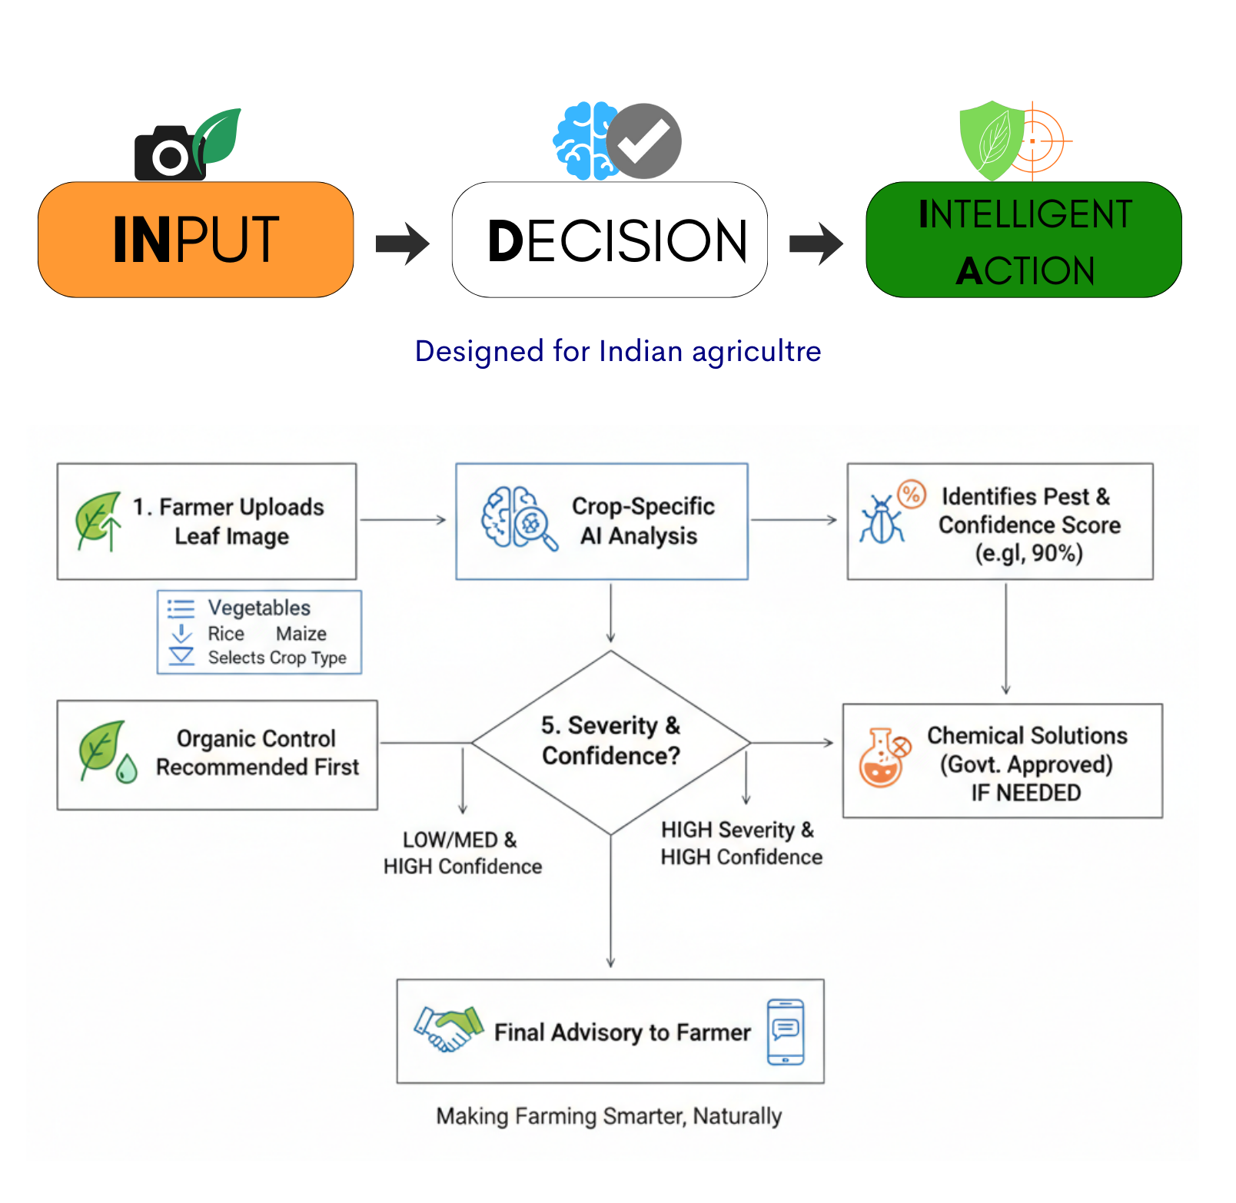

Decision Intelligence Flow: Smart Farming at Your Fingertips
Pestora transforms raw data into actionable insights, providing a clear path from problem identification to sustainable solutions.
Input
Leaf Image + Crop Type
Decision Intelligence
AI Pest Detection + Confidence Score
Action
Organic Solution → Approved Chemical (if required)

Slide 6





Rooted in Reality: Designed for Indian Agriculture
Pestora is built with the specific needs and challenges of Indian farmers in mind, ensuring practical and impactful application.
Low-Cost & Accessible
Developed to be affordable and user-friendly, ensuring broad adoption without financial strain on farmers.
Familiar Observation
Works seamlessly with what farmers already observe in their fields, integrating naturally into their routines.
Local & Government Aligned
Supports local farming practices and adheres to government agricultural guidelines for sustainable growth.
Real-World Focus
Specifically designed and tested for the diverse and unique field conditions across India.

Slide 7

Sustainable Growth: Our Revenue Model
Pestora's revenue strategy ensures wide accessibility for farmers while building a robust and financially sustainable future.
1
2
Core System Access
Partnership Revenue
The fundamental pest detection system will be offered free or at a very low cost to farmers to maximize reach and impact.
Revenue will be generated through partnerships with agricultural colleges, NGOs, and agri-advisory services.
3
Government Programs
Collaborations with government digital farming initiatives will provide a scalable and stable income stream.
Ensuring Sustainability and Impact
Wide Adoption
Financial Stability
No Burden on Farmers

Slide 8
What Makes Pestora Unique? Our Unmatched Edge
Pestora stands apart by offering a tailored, confidence-driven, and farmer-centric approach to pest management.
Crop-Specific AI
Leaf-Image-Based
Beyond generic solutions, our models are precisely tuned for individual crops.
Intuitive detection using direct visual evidence from plant leaves.
Confidence-Aware
Organic-First Approach
Provides crucial confidence scores for every prediction, reducing farmer uncertainty.
Prioritizes environmentally friendly organic solutions for pest control.
Approved Pesticides Only
Affordable & Farmer-Centric
Recommends only government-approved pesticides when chemical intervention is essential.
Designed to be cost-effective and truly serve the needs of Indian farmers.

Slide 9








Pestora's Vision: Cultivating a Sustainable Future
Pestora is not just an AI tool.
It is a fundamental step towards transforming Indian agriculture for the better, fostering a future where farming is more intelligent, sustainable, and prosperous.
Trust-Based Decisions
Reduced Chemical Dependency
Empowering farmers with reliable, confidence-aware information.
Promoting organic solutions and minimizing harmful pesticide use.
Sustainable Indian Agriculture 🌱
Healthier Food Systems
Building a resilient and environmentally conscious farming ecosystem.
Contributing to safer, higher-quality food for all.

Slide 10

Meet the Innovators: Behind Pestora
We are a team of dedicated students from SSSIHL, Nandigiri Campus, driven by a passion for leveraging technology for social good.
1
SSSIHL, Nandigiri Campus
Proud members of a leading academic institution, fostering innovation and practical problem-solving.
2
Data Science Expertise
Our strong background in Data Science equips us with the analytical and technical skills to build robust AI solutions.
3
AI for Social Good
Deeply passionate about applying artificial intelligence to address real-world challenges, particularly in sustainable agriculture.
4
Ethical & Impactful Technology
Committed to developing technology that is not only effective but also ethical, responsible, and creates lasting positive impact.

